Slide 1
Housing Accountability and Production Office
Development-specific
State Housing Laws
Supports builders and local governments
Project Navigation, Accountability and Compliance, Interagency Coordination
Housing
Division
Long-Range Planning
Statewide Planning Goal 10 – Housing
Creates policies and rules
Housing Capacity Analysis, Housing Production Strategy, Oregon Housing Needs Analysis
Guidance
Technical Assistance
Housing Production, Affordability, and Choice
Local and state partnership to meet housing goals
Notes:
ROLES:
HAPO -
Housing -

Slide 2



Housing Accountability and Production Office (HAPO)
Joint Office
Created in
SB 1537 (2024 Session)

Slide 3



Housing Accountability and Production Office (HAPO)
Purpose: Supporting developers and local governments to boost housing production
Approach: Collaboration first, enforcement last
What We Do:
Ensure local land use codes and decisions meet state law
Technical assistance & funding for local governments
Research & guidance to reduce barriers to production (model code & ‘ready-build’ plans)

Slide 4
Inquiry Categories
Inquiry to HAPO
Informal
Land Use Guidance:
Includes sections or ORS 92, 197, 197a, 215, 227
Informal
Building Code Guidance:
Includes sections of ORS 455
Formal Housing Law Complaint:
Allegation of land use or building code law violation
Navigation:
Locating housing
resources and requirements
managed by the state

Slide 5
Housing Laws
Land Use
Clear and objective standards
Middle housing and ADU requirements
Land divisions, subdivisions, and partitions
Affordable housing allowed outright
Mandatory adjustments (SB 1537)
Planning and zoning hearings and review (cities and counties)
Building Code
Permit and plan review timelines and applications
Construction document and submittal document requirements
Oregon Residential Specialty Code
Oregon Structural Specialty Code
Cite it write it
Structural design requirements; fire and life safety; accessibility

Slide 6
Housing Production Navigation
Navigation: Assistance with state resources and requirements
Purpose: Make it easier to find the right people and programs
Example Inquiries:
  Identification of funding
  Clarification and understanding of state processes

Slide 7
Total Inquiries

Slide 8
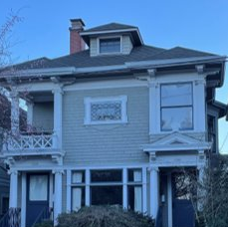
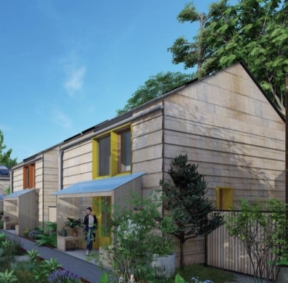
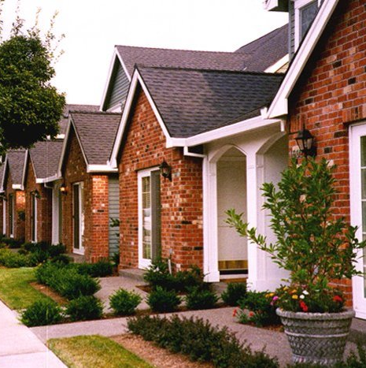


Overview of 2025 Session Housing Bills
HB 2138
HB 3144
HB 2258
SB 974
HB 3031
Expands where middle housing is allowed – unincorporated urban lands
Retroactively invalidates CC&Rs that prohibit middle housing or ADUs
Limits traffic impact analyses and exactions for small middle housing and infill developments
Invalidates CC&Rs that prohibit factory-built housing enacted after January 1, 2026
LCDC to adopt rules to establish preapproved site criteria where local governments will be required to permit residential development
Works in coordination with BCD preapproved plans program
Creates a 120-day shot-clock for engineering review of residential development applications
Creates an “urban housing application” to make residential development to go through an administrative review process
Prohibits application of design standards to 20+ unit developments (excluding multifamily)
Creates Housing Infrastructure Fund at BizOR
Appropriates $10m to fund, with direction to return for legislative project approval in 2026

